Slide 1
Primary Music Network Meeting
Wednesday 23rd March 2023
Becky Stroud
Primary Music Teacher
rstroud@beckprimary.co.uk
beckystroud@redtape.org

Slide 2
Outline of Session
Welcome Warm Up
Signposting – national, regional, local
Ofsted Music Deep Dive – Bernie and
Music Development Plan
Time to chat/help each other
Evaluation

Slide 3
1 Welcome Warm Up

Slide 4
2 Signposting – National News
New proposed Music Hub Structure:
South Yorkshire Music Hub (Barnsley, Doncaster, Rotherham + Sheffield)
Down from over 100 hubs to 44
Have you say: survey is open from Friday 10 March until 5pm on Friday 31 March.
https://www.artscouncil.org.uk/conversation-and-consultation

Slide 5
2 Signposting – Sparkyard

Slide 6
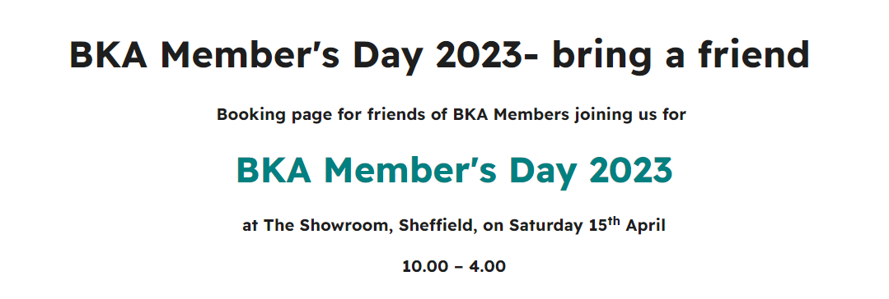
2 Signposting - Local
https://www.kodaly.org.uk/event/bka-members-day-2023-bring-a-friend?fbclid=iwar0wv1do0au6x7hmcocbmbozimt2ctvw6iw4tytebhjwfhuwgkkkbxz0wr8

Slide 7
2 Signposting – NSSP
Sheffield Cathedral – National School’s Singing Partnership £75k
Any school interested email: enquiries@sheffield-cathedral.org.uk
https://www.sheffieldcathedral.org/news/sheffield-cathedral-brings-the-joy-of-singing-to-school-children

Slide 8
2 Signposting - Music Hub 2023/4
Learn to play a musical instrument
(Primary/Secondary/Special)
Standard Package £1,495 A specialist musician will teach 1 class for 45 minutes each week (30 planned sessions maximum). Class teacher involvement is key to the success of this programme which includes the loan of musical instruments. Your school staff will be invited to a Twilight CPD session in September to launch the programme, empower teachers and share curriculum resources.
Enhanced Pathways Package £2,093 As above plus an additional half hour for up to 10 children who wish to continue after the 1st year. Only £724.65 for each additional half hour session after this. The package includes the loan of musical instruments, co-designed opportunity for the young musicians to experience a live performance together with their Music Leader and your school staff will be invited to a Twilight CPD session in September to launch the programme, empower teachers and share curriculum resources.

Slide 9
2 Signposting - Music Hub 2023/4
Learn to sing Primary
Our singing packages run for a set 30 weeks over the academic year – they are designed for the same class to have a lesson each week (for 10 weeks a term) for the whole year.
Standard package £2,915 an expert vocal music leader will visit your school for half a day per week, 30 weeks across the academic year. A comprehensive singing programme for 3 classes of 30 children each week. This package also includes one CPD per term for teachers and support staff, Curriculum Support, A scheme of work, repertoire and resources.
Enhanced package £5830 as above for maximum 6 classes for a full day per week for 30 weeks

Slide 10
2 Signposting – Music Hub 2023/4
Learn to sing Bespoke for Special Schools
Standard package £1,558.25 an expert vocal music leader will deliver 30 engaging bespoke singing lessons throughout the academic year, culminating in a performance, or sharing to be arranged between school and your music leader. Sessions are up to an hour in length.
Music – Choir Bolt On
NOTE - This is only available when purchased alongside a Learn to Sing package. The choir may run within the school day, or immediately before or after it.
Standard package £1,523.81 includes 30 rehearsals from a vocal music leader, plus 2 performances to be arranged with your music leader. The choir leader will work alongside a member of school staff who must assist with the overall running of the choir. Sessions will run for up to 45 minutes.

Slide 11
2 Signposting – Music Hub 2023/4
The Recorder Revolution (NEW PROGRAMME)
Standard Package £850 Super charge your teachers’ skills within your school with the Recorder Revolution. The programme is designed to upskill, build confidence and leave a musical legacy within your school for you to use year after year or across several year groups per year. It is a package designed to work alongside your music curriculum giving your teachers the resources, training and motivation to deliver high quality music curriculum in your school.
THIS PROGRAMME IS DELIVERED BY YOUR CLASS TEACHERS ON A WEEKLY BASIS
The programme includes:
High Quality class set of recorders for the children to keep
Full scheme of work and planning to cover an entire first year of learning.
Full set of teaching resources and music to play
Support to link learning into your wider music curriculum and school music development plan
Termly twilight CPD for participating class teachers, support staff and any other additional staff to launch the programme, upskill the teaching team and introduce the resources and learning scheme.
Opportunity for the children to take part in a massed performance in the University of Sheffield Octagon Centre in July 2024 with children from other participating schools. This performance will be open to parents and carers of the children taking part.
Additional class recorder sets are available to purchase for the cost of £295 (price for 30 instruments – specially selected high-quality instruments)

Slide 12
2 Signposting – Summer term
Friday 30th June 2023 - One Voice Festival
This exciting project will include:
Two CPD training sessions
Two supportive videos for your class to take part in
Continued support from the project lead
A live performance at the University of Sheffield’s Octagon Centre alongside 600 children and 600 audience members!
A live recording of 1 song, released on Sheffield Music Hub’s YouTube Channel, for you to share with families, friends and other pupils from school.
Families will be able to watch the event live at the Octagon on a first come, first served basis when tickets are released - more information on tickets will follow. We will also record 1 song which will be released on YouTube for you to share with your families and other pupils.
Each KS2 class (*up to 35 students) attending the event will cost £300. There are spaces for 16 KS2 classes to take part and these will be allocated on a first come first served basis.
Applications will open w/c Monday 30th January and sign up will close on Friday 31st March.
https://www.sheffieldmusichub.org/news/one-voice-singing-festival-2023

Slide 13
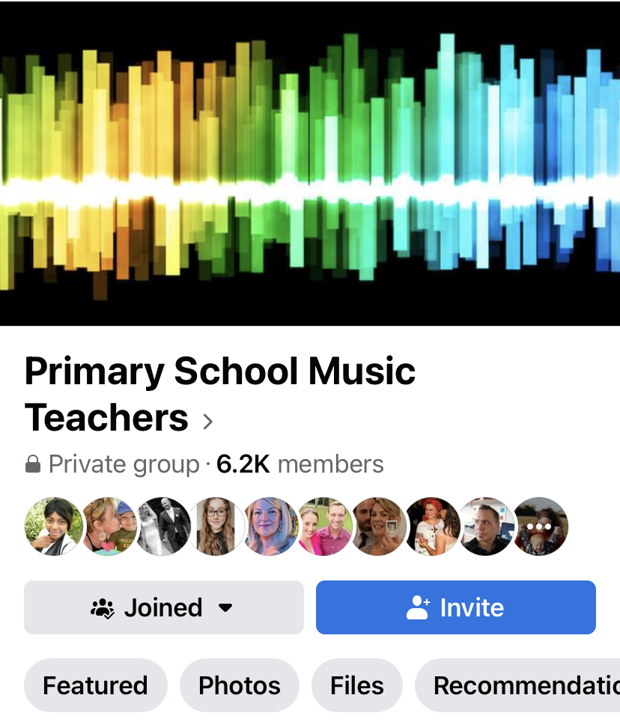
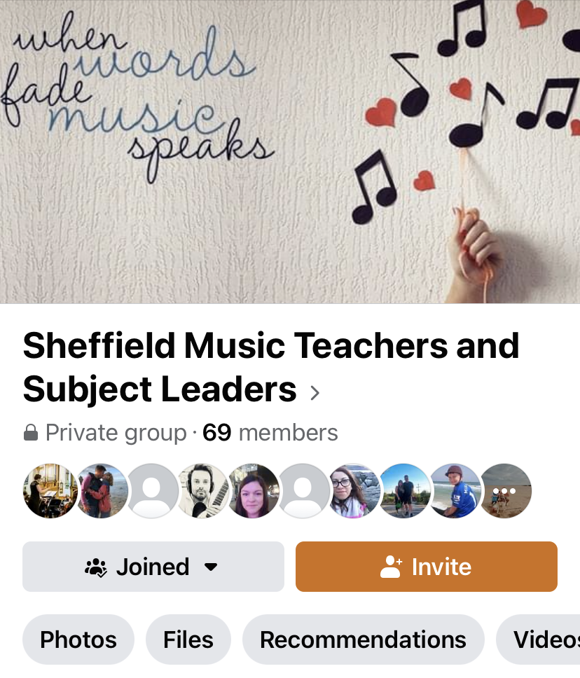
2 Singposting - peer support on fb

Slide 14
3 Ofsted Music Deep Dive:
Bernie Twomey
(St Marie’s Catholic Primary School)
Steph Coles
(St Wilfred’s Catholic Primary School)

Slide 15
4 Music Development Plan
Every school expected to have a
Music Development Plan in place
for September 2023
This session
Introduce Music Hub’s Self Evaluation framework to create your schools’ Music Development Plan https://www.sheffieldmusichub.org/downloads (file is ‘Music Teacher Self-Evaluation’)

Slide 16
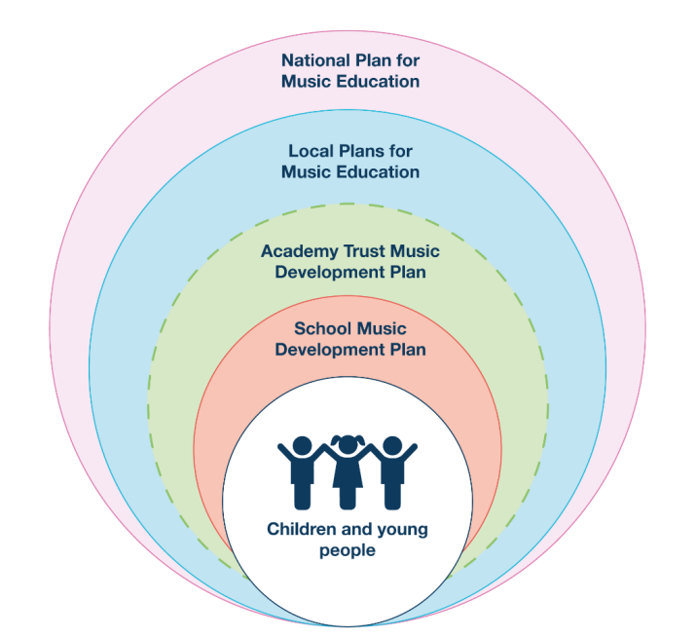
4 Music development Plan
The DfE would like to see offered in every primary school:
• high-quality timetabled curriculum of at least one hour each week of the school year
• Access to lessons across a range of instruments, and voice
• A school choir and/or vocal ensemble
• A school ensemble/band/group
• Space for rehearsals and individual practice
• A termly school performance
• Opportunity to enjoy live performance at least once a year
it’s an ambition, not finished product!

Slide 17
5 Time to chat/network/share/help each other

Slide 18
6 Evaluation
Please use the QR code to feedback on tonight’s session
Remember to:
Join the FB group ‘Sheffield Music Teachers and Subject Leaders’
Check out the self evaluation document to write your Music Development Plan here https://www.sheffieldmusichub.org/downloads
Find out who your link Music Leader by contacting Sheffield Music hub here: https://www.sheffieldmusichub.org/contact-us
https://www.learnsheffield.co.uk/Training/Subject-Leader-Networks

